Slide 1
KR wasted water treatment plant

Slide 2
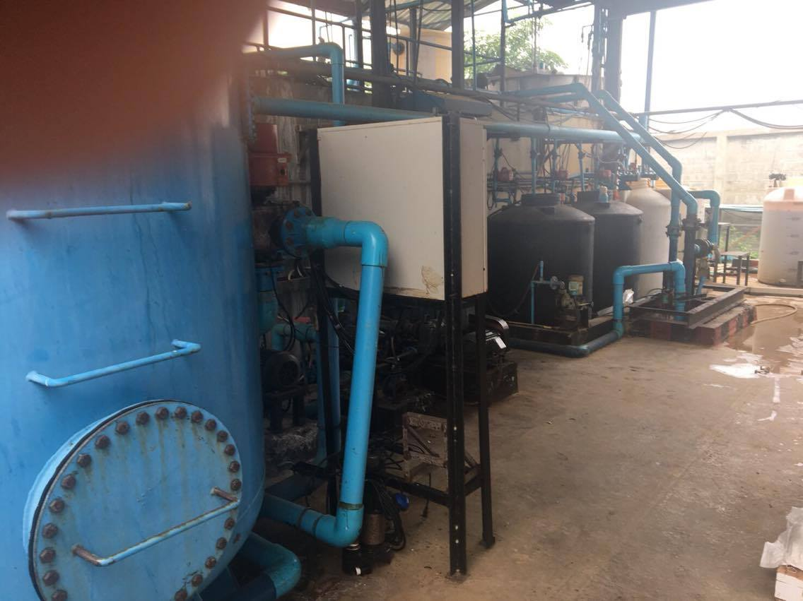
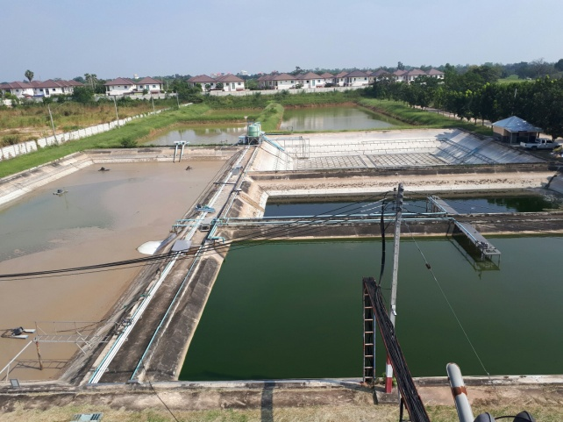
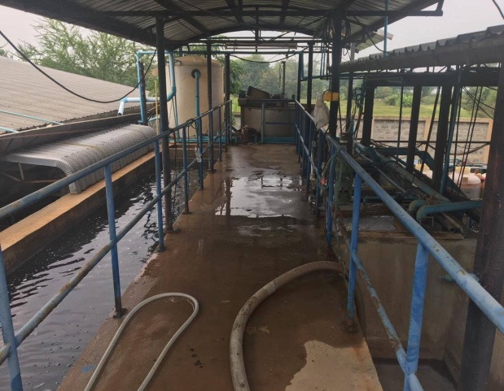
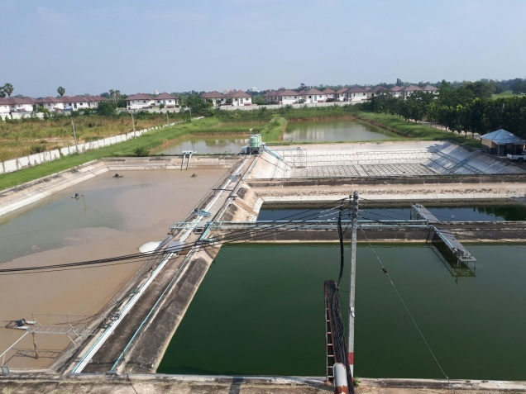
On-sited wasted water treatment plant
Neutralization
Filtration
Sediment
Wasted water/including chemical/
Detention pond
Sediment
Biologically remove S/S and lowering COD
KR’s in-site wasted water treatment plant is capable to treat 300-400mt of wasted water daily and have maintain team to perform daily maintenance.
The treated water will be sent out* an offsite detention pond to further treatment until the bimonthly water quality check by Khon Koan city official and got approval before we can release the water to the city sewer.
* Only the S/S and COD meeting the standard then we can send the treated water to detention pond

Slide 3
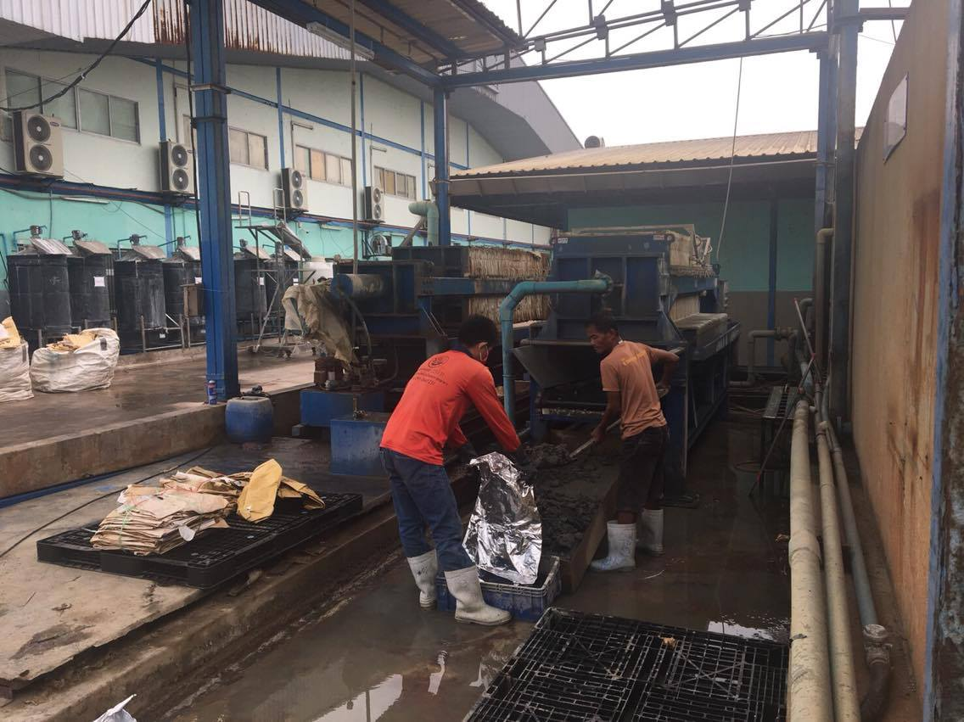
The filtered out solid waste and mud will be removed by qualified 3rd party waste management service on monthly basis or when needed.

Slide 4
KR production water treatment plant

Slide 5
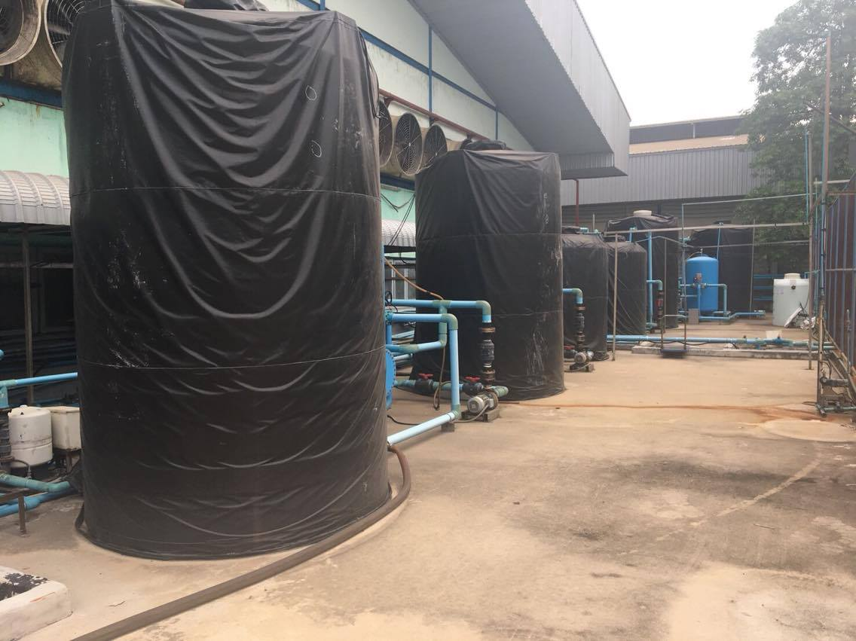
Specially designed for the washing process after tapering, since KR do not use any chemical after tapering process only use water to remove the chemical and particle on the filament. In order to save the water resource and minimize the water cost, the triple filtration system is designed and installed by 2014. The triple filtration system can process 150-250mt of water daily the process including Neutralization , First stage of filtration, 2nd state of filtration , Sediment and 3rd stage of filtration.
The treated water will be re-used into the washing process so to save water recourse.
3rd stage filtration
2nd stage filtration
1st stage filtration
Neutralization
With this system that we can extend the use of water by 4 days and save approx 60-70% of fresh water use daily. After 4 days the water will be sent to our on-site wasted treatment system for further treating process then release back to city sewer.

